Slide 1
Process dynamics

Slide 2
Process
set of activities or events that interact to produce a result
change between steady states is what interests us
Notes:
Understanding process dynamics is essential to effective control design.
Most design involves performing simple calculations based solely on few dynamic parameters.

Slide 3
Process
Process variable (PV)
- measured value (e.g. temperature)
Manipulated variable (MV)
- e.g. fuel valve
Kp - process gain
Notes:
A process variable is the current measured value of a particular part of a process which is being monitored or controlled. An example of this would be the temperature of a furnace. The current temperature is called the process variable, while the desired temperature is known as the set-point.

Slide 4
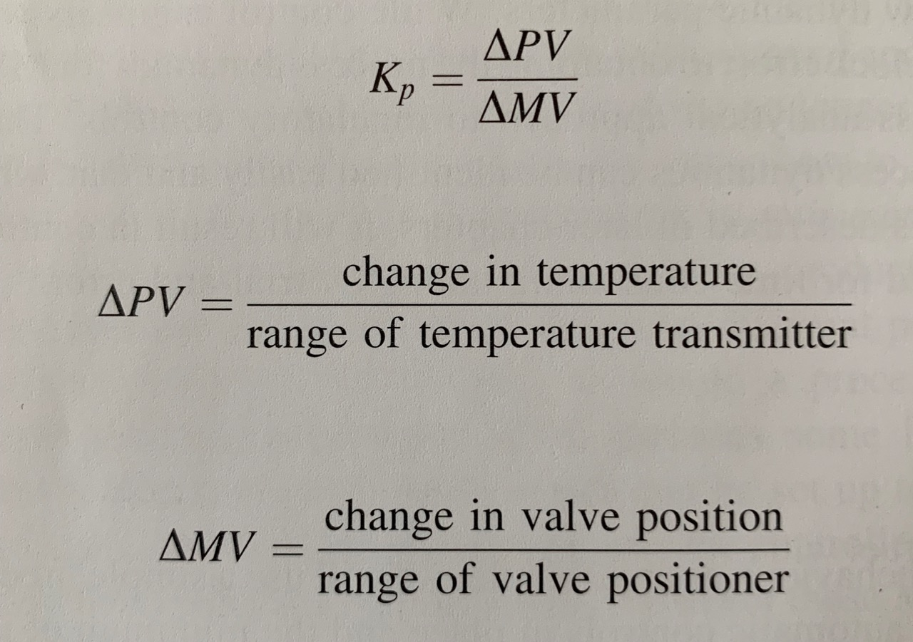

Slide 5
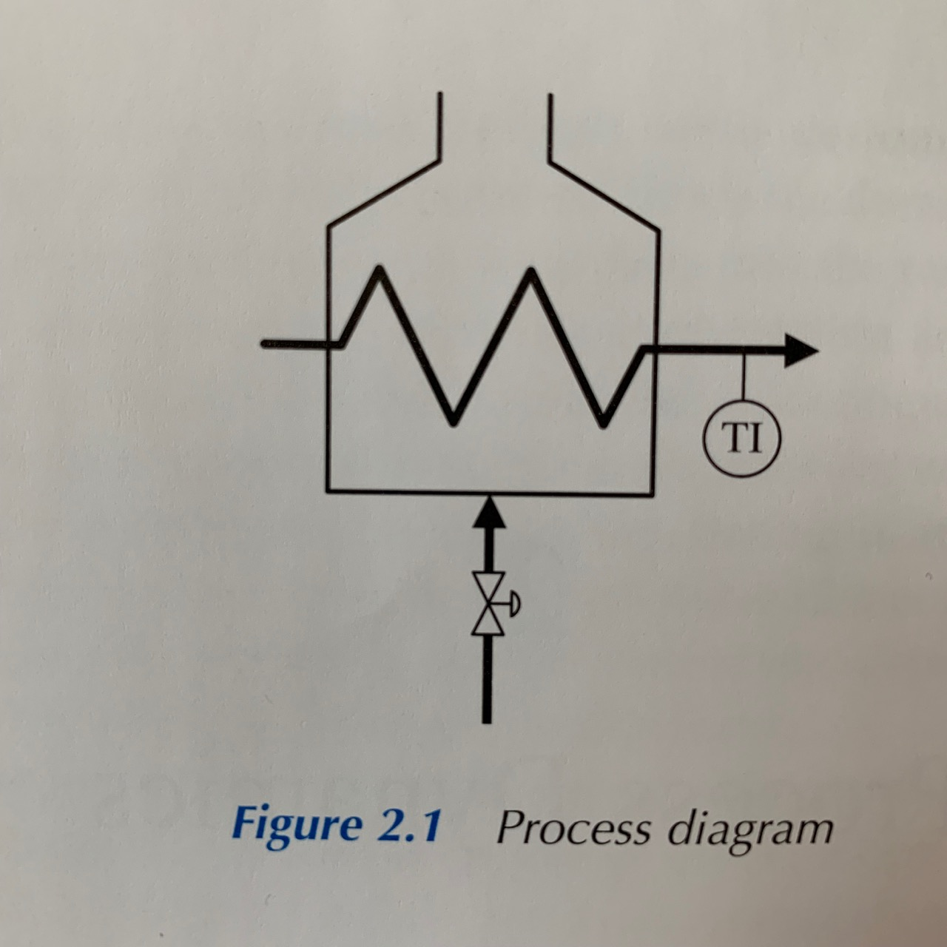
Notes:
We can describe process dynamics on example of simple fired heater, that has temperature indicator and fuel control valve.
When we manually increase the opening valve, temperature rises as the valve is opened.

Slide 6
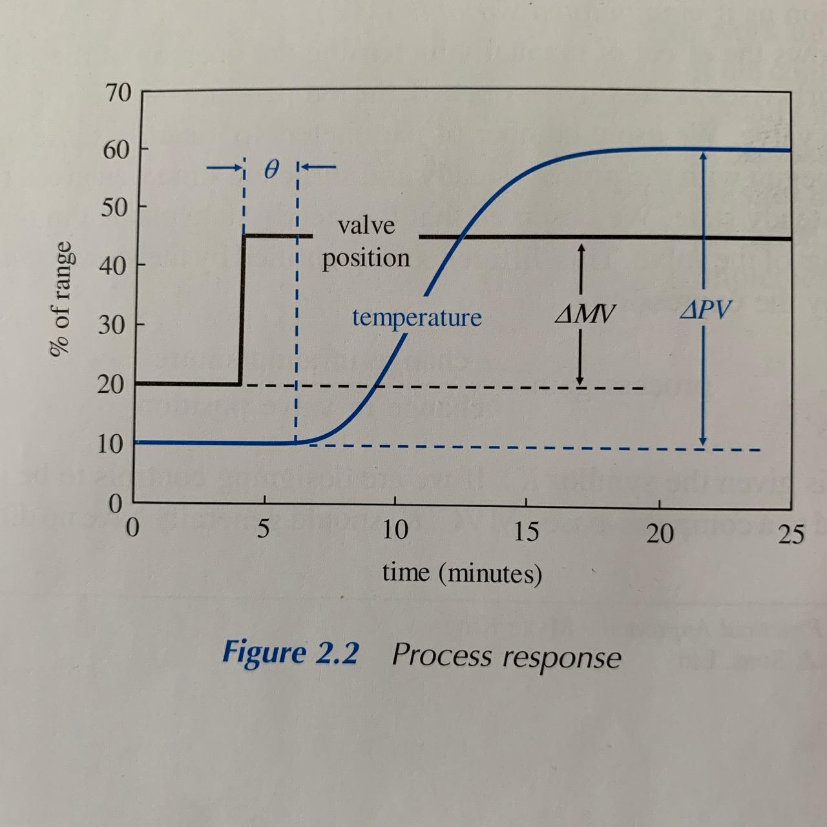
Notes:
The temperature trend is somewhat different from that of a valve - this delay is known as process deadtime. Deadtime is caused by transform delays - in this case, cause of the delay is the time it takes for the heated fluid to move from firebox to the temperature instrument.
The shape of the temperature trend is very different from that of the valve position. This is caused by the inertia of the system.
There is also possibility of lag, which is the delay between detection of an increase in temperature.

Slide 7
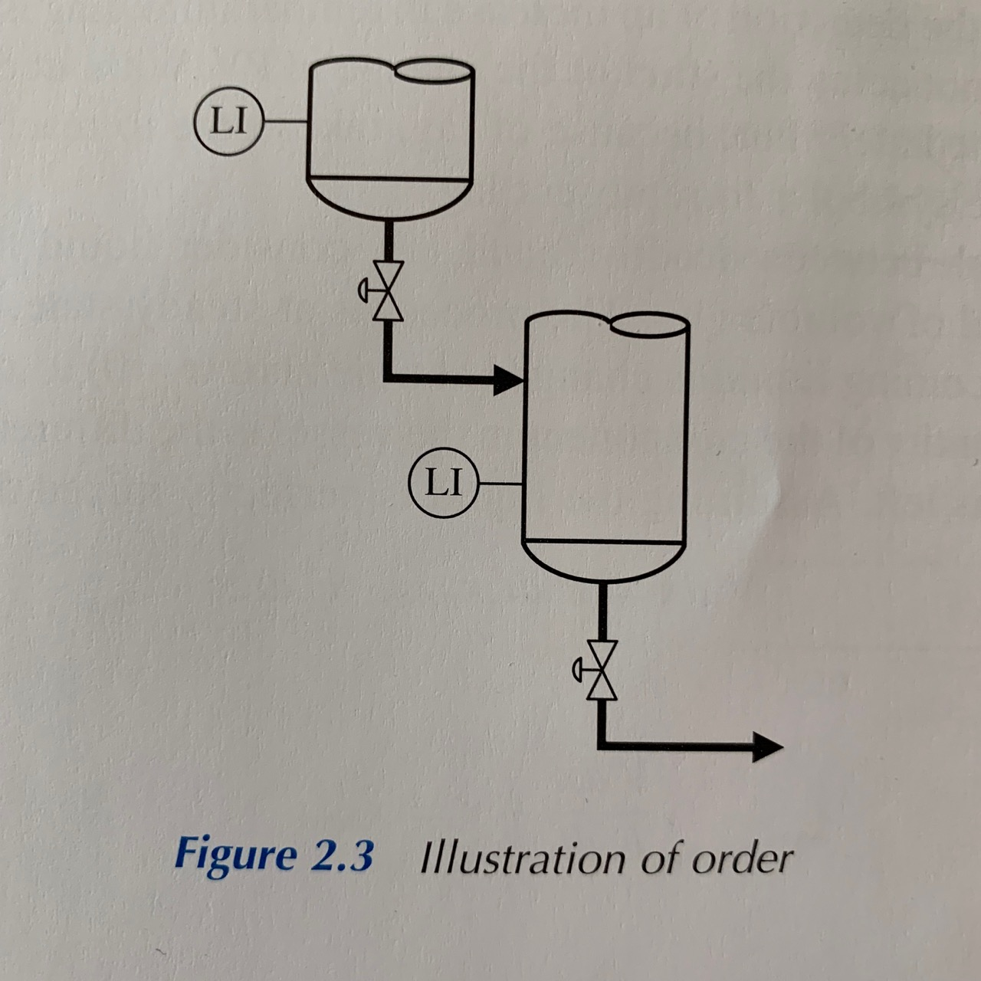
Notes:
When characterising shape of a trend of the process variable, we also have to consider order (n) of the process. Order can be thought of as the number of sources of lag.

